Slide 1

Human Errors
Asif Sharif Akash
20-42647-1

Slide 2

What is slip?
Slips are normally small: a misplaced action, the wrong thing moved, or a desired activity not completed. Furthermore, they are quite straightforward to detect through basic observation and monitoring.

Slide 3
Types of Slip
CAPTURE ERROR
DESCRIPTION ERRORS
DATA-DRIVEN ERRORS
ASSOCIATIVE ACTIVATION ERRORS
LOSS-OF-ACTIVATION ERRORS

Slide 4
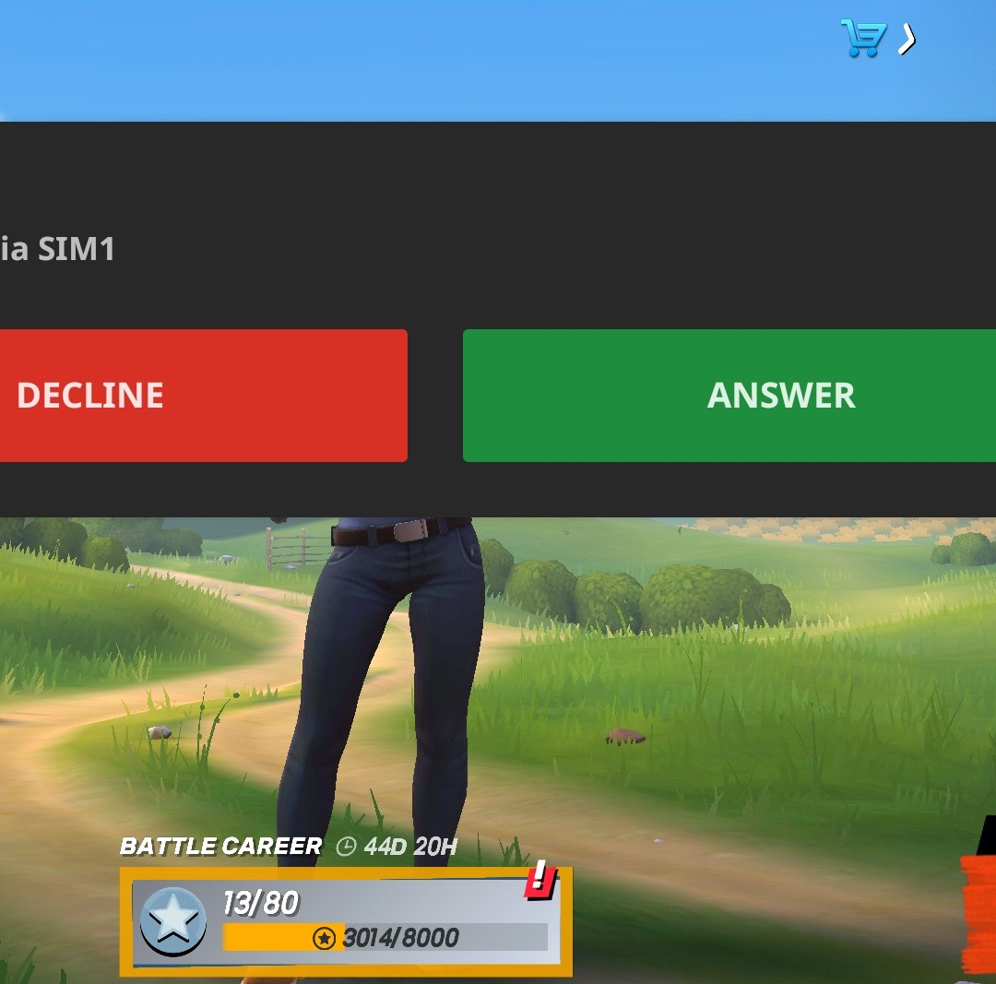
Capture Error
A capture error occurs when a less commonly occurring activity is implemented incorrectly because a more familiar behavior prevails, resulting in the mistake.
For example:
Recently, while playing a game on my cell phone, a call came in and I accepted it despite the fact that I had not intended to answer the call, and thus I attended the call without storing my game progress. So this is a capture error

Slide 5
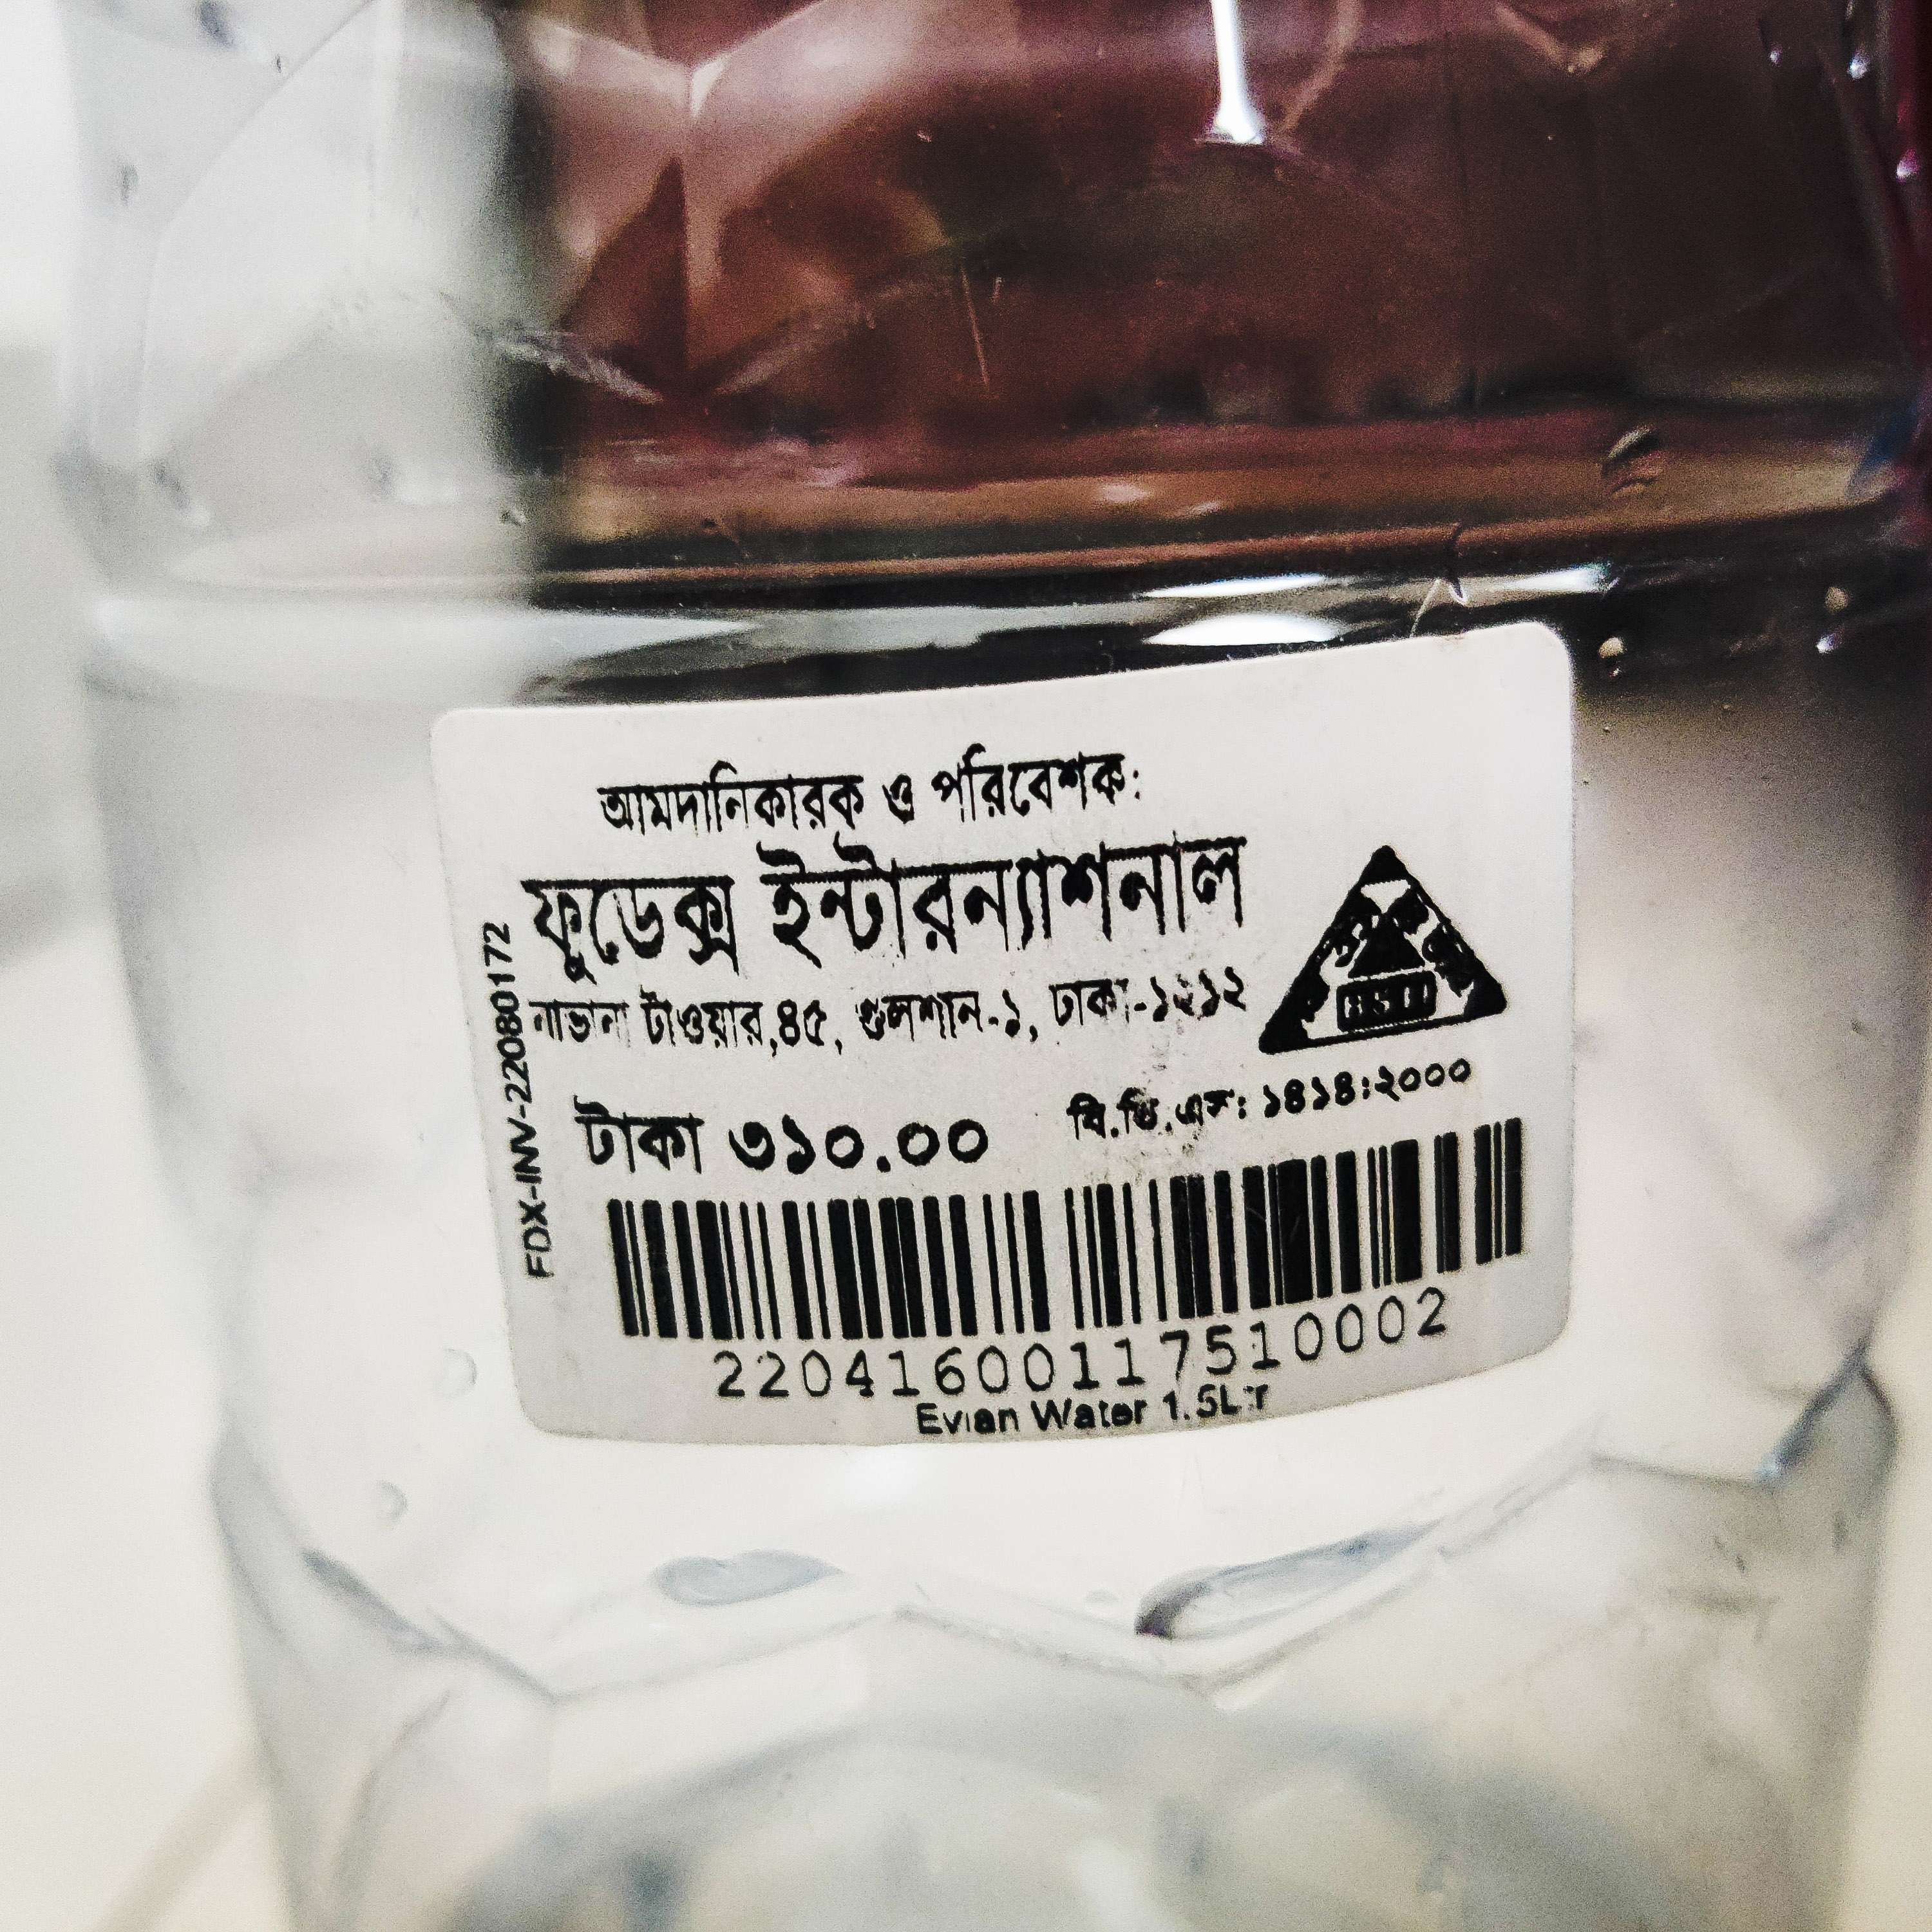

Description Error
When two activities are very similar, a description slip occurs. The user means to perform one action but mistakenly performs another.
For example:
After finishing my gym session a few days ago, I walked to the store to get a bottle of water. I didn't notice the price tag when I bought the water bottle, but after drinking it, I noticed it and it said 310 TK. A water bottle typically costs 30-40 TK. But here was one exception: the water in the bottle. As a result, this is a description error.

Slide 6
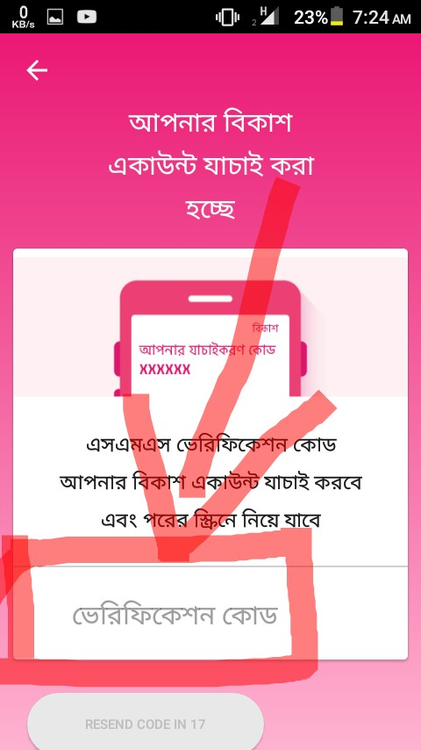
Data-Driven Error
When unconscious processing of external data interferes with what you wanted to achieve, this is referred to as a data-driven error.
For example:
As I was cleaning my phone one day, I uninstalled the bKash app by accident. As a result, after reinstalling it, it sent a verification code to my message app. When I entered my prior pin instead of the verification code, it did not accept it, and I became perplexed as to what went wrong.

Slide 7
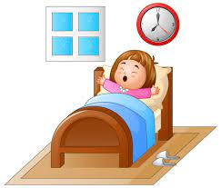
Associative Activation Error
When a thought or related idea interferes with the current activity when it is not appropriate, this is referred to as associative activation error.
For example:
I went to my sister's room yesterday to wake her up because it was time for our iftar. Then I began shouting out, "Hi, wake up!" . Why did I say hi wake up? So, this is associative activation error.

Slide 8
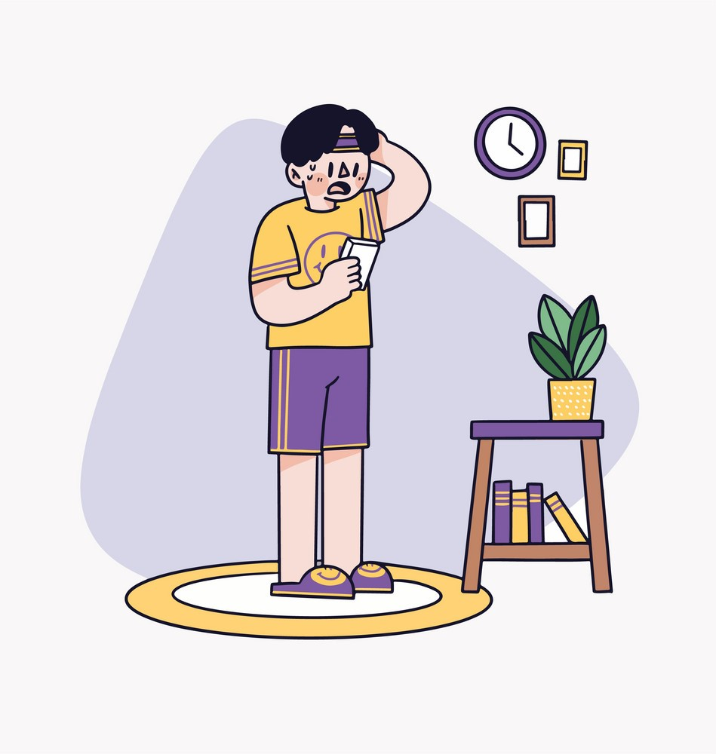
Loss-of-Activation Error
A loss-of-activation error happens when a goal-directed behavior is forgotten after it has begun.
For example:
When I go home from university classes, I normally take a shower or go to the gym, but a few days ago I returned home and went over my cellphone since I forgot what to do.

Slide 9
THank You
ASIF SHARIF AKASH
20-42647-1

